Slide 1


Student Attendance Management System
Problem Statement: Manual attendance tracking is time-consuming, error-prone, and difficult to manage efficiently.
Target Users: Schools, Colleges, Teachers, and Training Institutes
Notes:
1

Slide 2
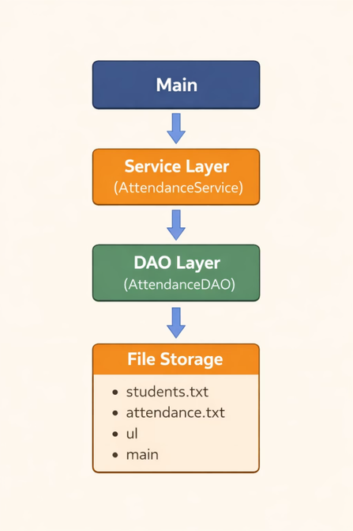
System Design
High-Level Architecture
Key Classes & Responsibilities:
Student → Stores student data
AttendanceRecord → Stores attendance details
AttendanceDAO → Handles file operations
AttendanceService → Business logic
Main → User interface
Package Structure:
model → Data classes
dao → File handling
service → Logic
exception → Custom errors
ui → Interface
main → Entry point
Notes:
2

Slide 3
OOP Concepts Used
Abstraction
Inheritance
Polymorphism
Service layer hides file handling logic
StudentNotFoundException extends Exception
Methods behave differently based on input (status, ID)
Encapsulation
Design Pattern
Private variables with getters/setters
Layered Architecture (UI → Service → DAO)
Notes:
3

Slide 4
Technical Highlight
Attendance Calculation Logic:
Attendance % = (Present Classes / Total Classes) × 100
Why Chosen:
Simple and efficient
Works for all data sizes
Helps identify low attendance
Extra Feature:
⚠ Warning shown if attendance < 75%
Notes:
4

Slide 5
Live Demo
Working System:
Add Student
Mark Attendance
Show Students
Calculate Percentage
Example Scenario:
Student Rahul → 2 classes
1 Present → 50% attendance
⚠ Warning displayed
Error Handling:
Invalid ID → "Student not found"
Empty input → "All fields required"
Wrong input → "Invalid option"
Notes:
5

Slide 6
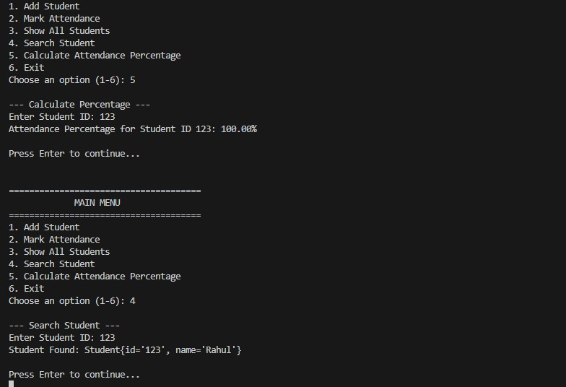
Notes:
6

